Slide 1

A COMPLETE ERP SYSTEM
Name – Daksh Purohit
Section – D1
Roll No – 18
Mentor – Mr Akash Chauhan

Slide 2
Introduction
The ERP Portal project is a comprehensive web-based application designed to facilitate user authentication and profile management within an enterprise resource planning (ERP) system. Leveraging Node.js and Express.js for the backend, it efficiently handles user sessions and database interactions with MySQL, while the frontend, built with HTML, CSS, and JavaScript, provides a seamless and interactive user experience. The application features secure login and signup processes, user profile updates, and personalized greetings. This project serves as a practical educational tool for understanding full-stack development, database management, and web security, while also laying the groundwork for scalable and extensible ERP systems. Its modular design and emphasis on user experience and security make it a robust solution for real-world business applications, addressing common web application needs and preparing developers for market demands.

Slide 3
METHADOLOGY

Slide 4



User Authentication:
Users can log in using their username and password.
LOGIN
New users can register by providing a username, password, roll no,10th percentage, 12th percentage and their profile photo.
SIGNUP
User sessions are managed to keep track of authenticated users.
SESSION MANAGEMENT

Slide 5


User Profile Management:
Authenticated users can update their profile information, such as username and password.
PROFILE UPDATE
The application greets the logged-in user by displaying their profile photo, username, roll no,10th percentage, 12th percentage .
PROFILE DISPLAY

Slide 6
SNAPSHOTS

Slide 7
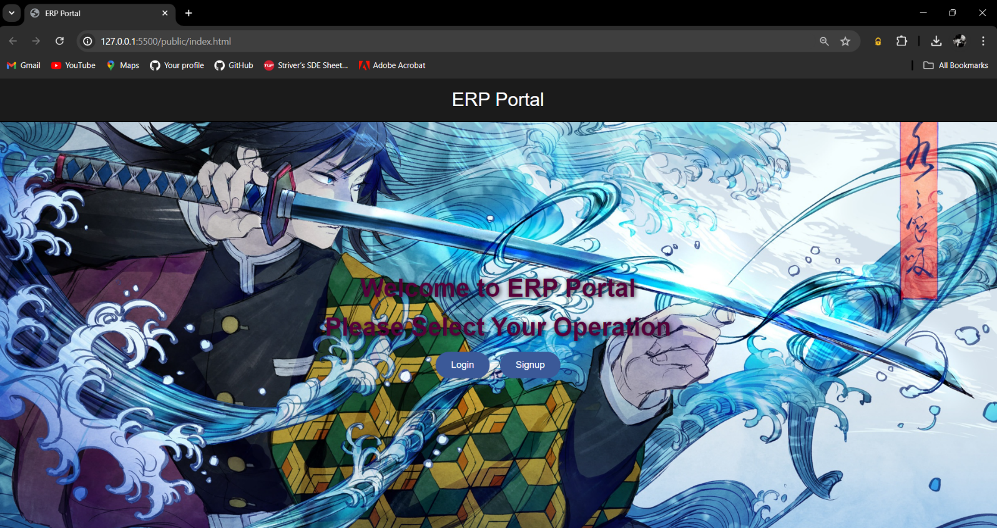
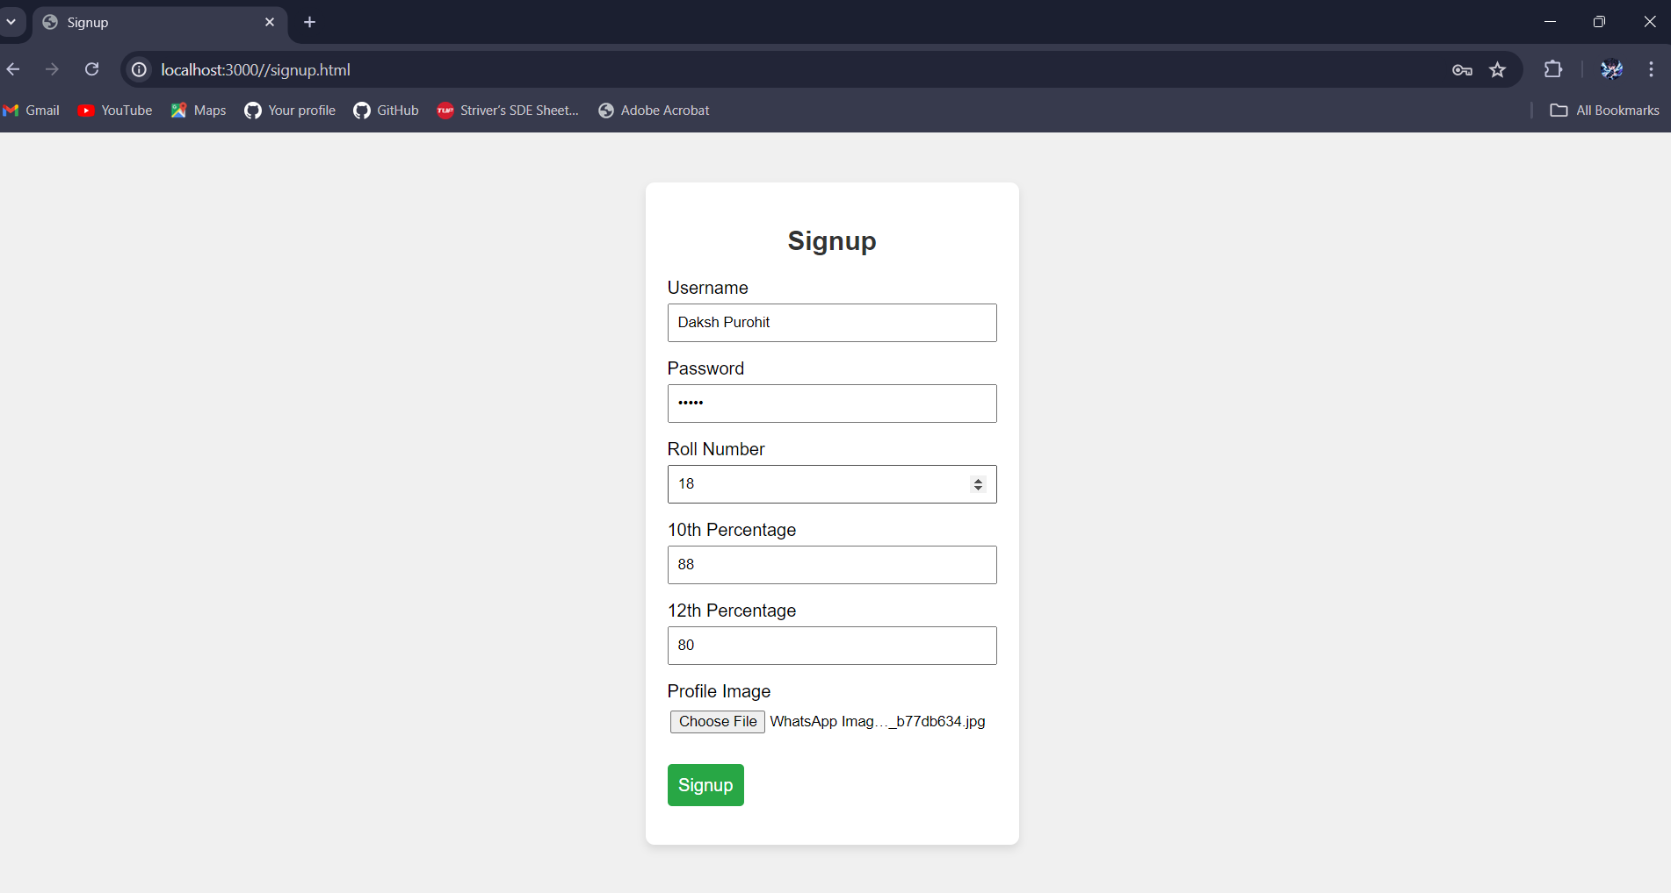


Slide 8
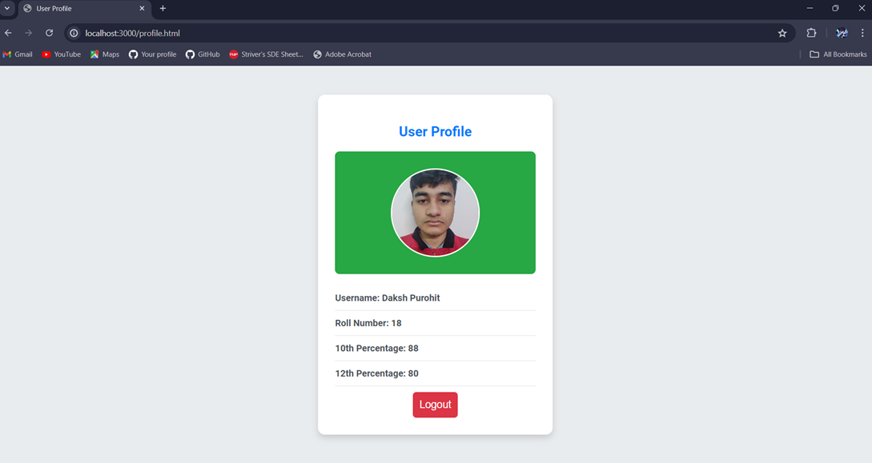
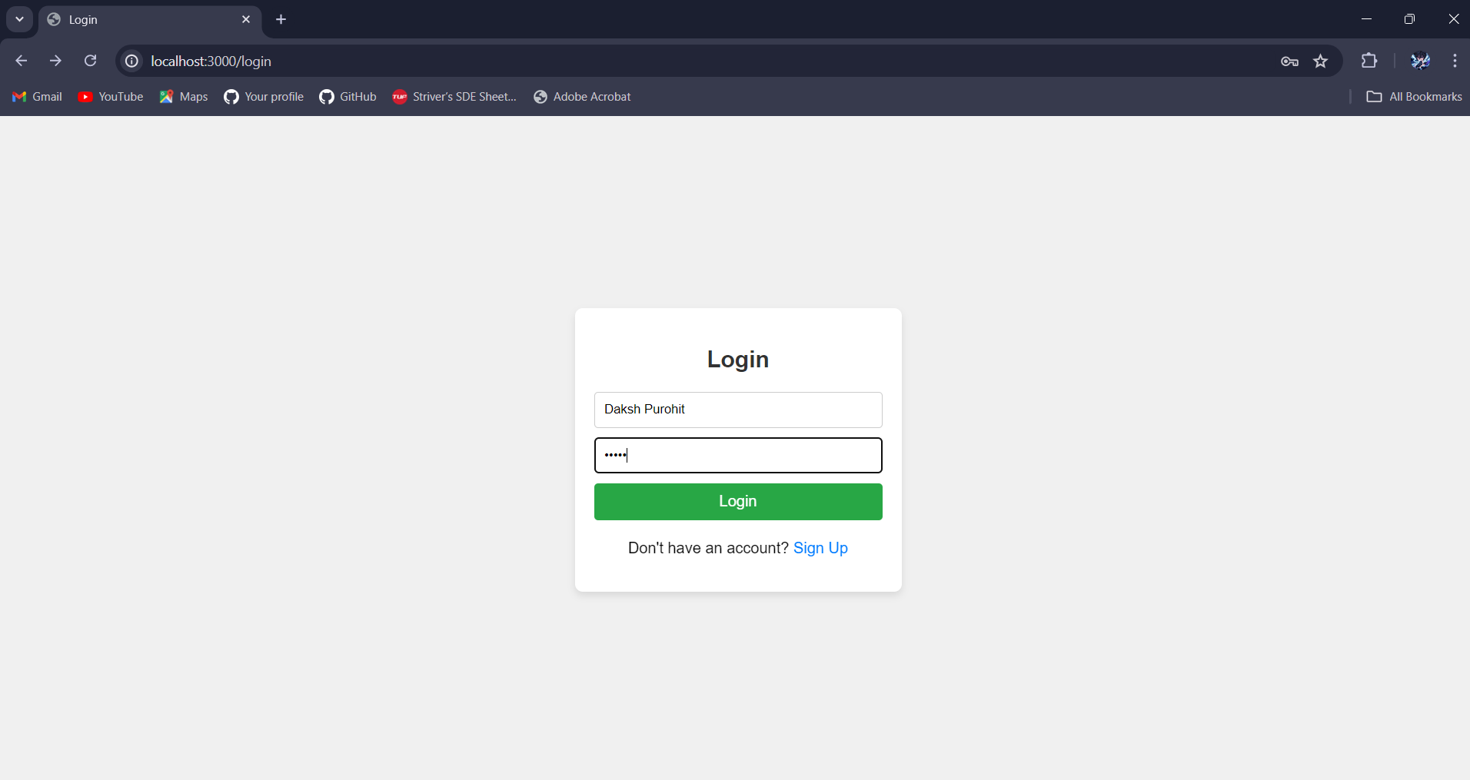

Slide 9
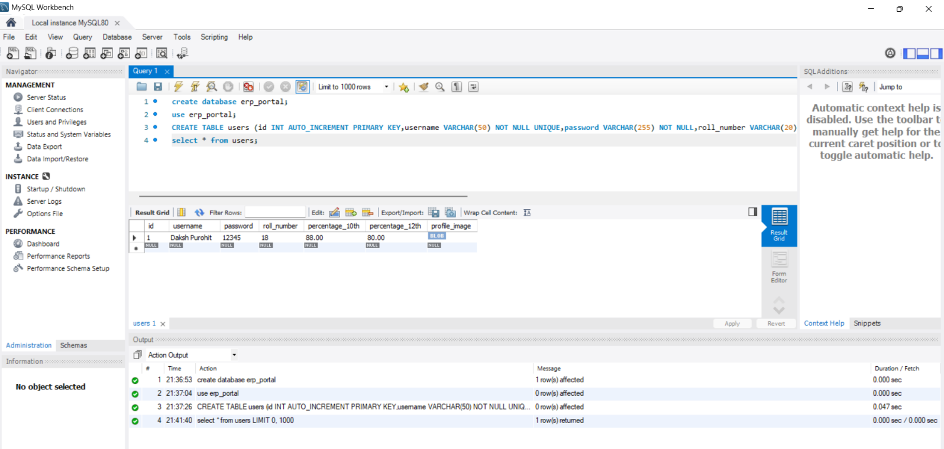
DATA WILL BE STORED IN DATABASE

Slide 10

conclusion
The ERP Portal project successfully demonstrates the development of a fundamental web-based application for user authentication and profile management, integral to any enterprise resource planning (ERP) system. Through this project, key skills in full-stack development were honed, utilizing Node.js and Express.js for the backend, MySQL for database management, and HTML, CSS, and JavaScript for the frontend. The application features secure login and signup functionalities, user profile updates, and personalized greetings, providing a robust and user-friendly experience. This project not only serves as a practical educational tool but also lays a strong foundation for building more complex and scalable ERP systems. It emphasizes the importance of web security, efficient database interaction, and seamless user navigation, making it a valuable resource for both learning and practical application in real-world business environments.

Slide 11

Thank yoU

